Slide 1
Discrete Mathematics and Logic (UE18CS205)
Mr. Channa Bankapur (channabankapur@pes.edu)
Department of CS&E, PES University

Slide 2
Math for Computer Science:
Logic and Boolean Algebra
Set Theory
Combinatorics
Relations
Mathematical Induction
Graphs
Trees
Probability
Statistics
Linear Algebra
Number Theory

Slide 3
Motivation:
It’s a core course, and hence mandatory!
(It cannot be the only reason)
It’s the first course in Theoretical Computer Science.
It’s where Math meets Computer Science.
It’s a prerequisite for all Theoretical CS courses and also theory behind several applied courses like Digital Logic, Data Structures and Algorithms.
Mathematical Reasoning and Mathematical Modeling.
Algorithms involving discrete structures like Sets, Counting objects, Graphs, and Algebraic Structures.
Logical Reasoning and Competitive exams
Job interviews

Slide 4
Applications of DML:
Design of computing machines
Specification of systems
Artificial Intelligence
Computer Programming
Programming Languages
Proving correctness of a Computer Program
Automated Reasoning Systems
Basis for all other Theoretical Computer Science topics

Slide 5
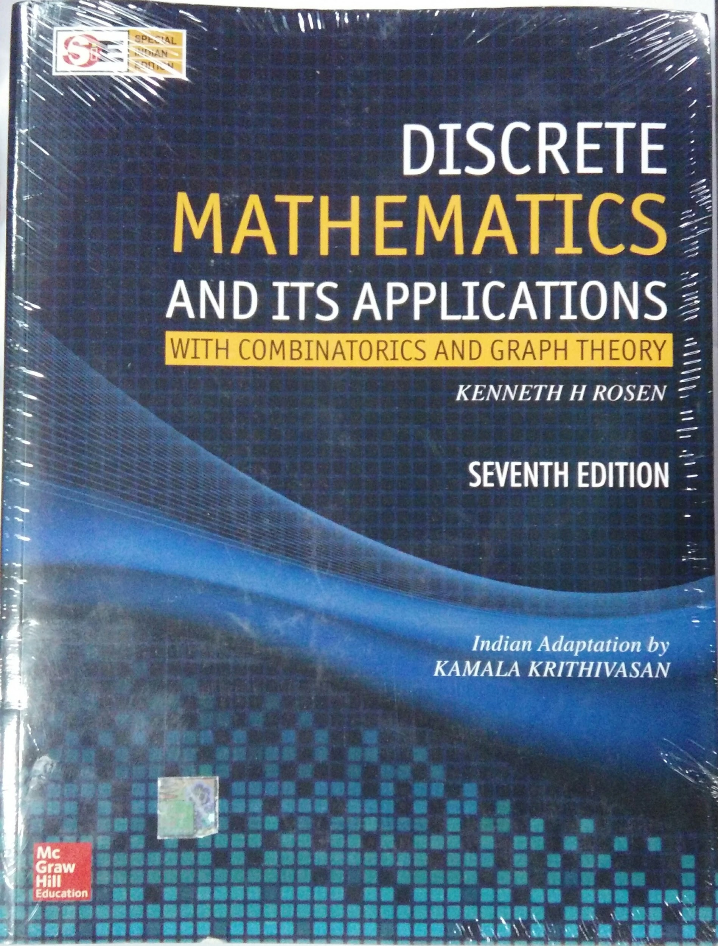

Slide 6
Syllabus Contents:
Logic
Propositional and Predicate Logic
Rules of Inference, Arguments and Proofs
Sets, Functions and Relations
Equivalence Relations and Partial Orderings
Counting
Permutations and Combinations
Binomial Coefficients
Induction, Recursion and Recurrence Relations
Graphs
Algebraic Structures
Groups and Rings
Coding Theory

Slide 7
2015:
Logic
Sets
Counting
Graphs 1
Graphs 2
2016:
Counting
Logic
Sets
Graphs 1
Graphs 2
2017:
Counting
Logic
Sets
Recurrences
Graphs
2018:
Logic
Sets
Counting
Recurrences
Algebraic Structures

Slide 8
Assessment:
ISA (Max: 40 points)
Test 1: 15 points (Units 1 and 2)
Test 2: 15 points (Units 3 and 4)
Assignments: 10 points
ESA (Max: 60 points)
100-marks ESA paper
Course Anchor: Prof. Sangeetha V

Slide 9
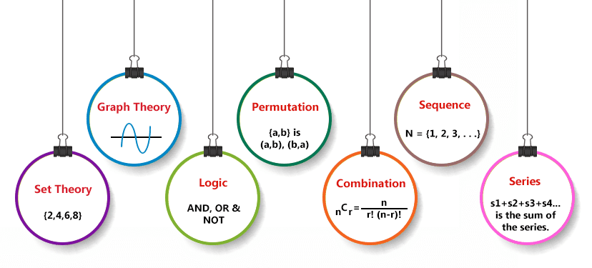
Let’s get started.. winter is coming!

